Slide 1
Workbook Investments (Planning)
Internal Use Only
April 2017
EXCEL FILE:

Slide 2
Disclaimer
The content of this workbook has been produced by KPMG Germany/Deal Advisory on the basis of German accounting standards and/or IFRS, as well as considering KPMG Germany’s firm and country requirements, regulations, processes, policies and best practices. Please check your local accounting and other requirements before applying the content.

Slide 3
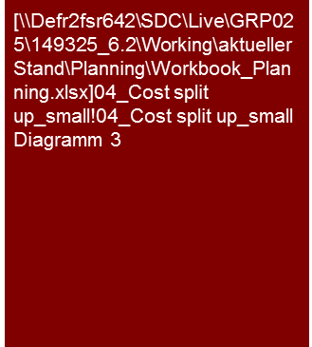
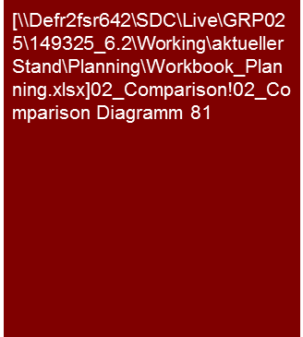
Overview (1/4) – Mission statement
Flag: Analysis Toolbox and K-Reinvest are specific tools used in Germany for valuation practice and they are not available globally.
Benchmarking Plus tool is available in Germany. Please ask for benchmarking options in your region.
Investment (Planning)
Mission Statement:
Transparency about the future capital structure, security of financing and market conformity of the financing for the proper consideration in transactions/valuations
Customer situation
Definition/Methodology/Tools of the basis analysis
Buy Side/Sell Side/JV
Drivers for valuation and, if necessary, purchase price approval (e.g. determination/calculation of investment need)
Corporate Health
Significant influence factor for the short and mid-term liquidity (frequently limitation of the investment budget)
Depreciation and investments over time
Definition and Methodology
Discussions with planning responsible
Obligatory linking of the knowledge from the past analysis and the market and competitive analysis with the planning analysis
Connection of the investment analysis with sales, maintenance expenses, balance sheet and depreciation analysis
Analysis and/or presentation at selected levels (e.g. group, legal entity, segment, profit center, product group, region, etc.) in accordance with the necessity, appropriateness and data situation in the specific case
Involvement of the client’s technical team or the technical consultant
Tools
Analysis Toolbox (e.g. KOut, KPlan, KValue)
K-Reinvest for derivation of the sustainable reinvestment ratio (for valuation purposes; see Sustainable Result (income)/ Terminal Value workbook)
Investment rate in comparison to peers
Degree of standardization
Toolbox
Determination and collection of sector-specific KPIs (Benchmarking Plus)

Slide 4
Overview (2/4) – Analysis puzzle
Investment (Planning)
Market and competitive analysis^{(a)}
Market
Results of analysis
Core statement/Conclusive valuation
Comparison
with
past
Comparison with market expectations
Regulatory requirements
Planned/ Actual comparison adherence to budget(c)
Material projects
Analysis of past^{(b)}
Planning analysis investments
Capacities needed for sales^{(d)}
Comparison
with
peers
Product/Segment/
Regions mix
effects
Financing available^{(e)}
Peer group
Note: a) See Market Analysis workbook; b) see Expenses (CoS or TCM) workbooks; c) see Planning Process and Adherence to Planning workbook; d) see Investments (Planning) workbook; e) see Normalized Earnings workbook; f) see Synergy Management workbook

Slide 5
Overview (3/4) – Pitfalls
Investment (Planning)
No. | Pitfalls/Lessons learned
 | Comparability: With the analysis of the past and planning as well as the benchmarking of the planning in the market and competitive environment/peer group, the general comparability of the parameters analyzed is to be assured, if necessary by means of adjustments/transitions. Differences may be found in: The delineation: Differences in financial reporting standards or utilization of accounting options (e.g. presentation as expenses vs. capitalization and depreciation) The fundamental design and arrangement of economically identical/similar issues: Various measures for achieving the same economic result (e.g. acquisition vs. leasing/rental) The timing: Companies frequently find themselves at different times of an investment cycle. The analysis/comparative period should cover a complete investment cycle and, if needed, focus on average investment. A lack of complete comparability (e.g. lack of information about the impact of options, etc. with peers that appear to be material) is to be mentioned and appropriately recognized (e.g. “only limited validity“).
 | Planning depth: Frequently, the first planning year (budget) is detailed and therefore planned realistically or even conservatively because other processes are based on them (remuneration, metrics, target attainment) and measurement can be made promptly (current trading). Subsequent planning years are generally not included here and are frequently based on a reduced depth of the planning assumptions. They are often planned generally, frequently much “more fancifully” (higher growth, increase in margins) (similar to a strategic outlook) and therefore should be viewed more critically.
 | Cyclical nature: Frequently companies invest in more or less strongly pronounced cycles. Especially in cases of long investment cycles (e.g. power plants, chemical plants, etc.) the assessment of the current status of the existing plant and an estimation of the necessity and timing of major investment is material (length of planning horizon sufficient? → see Sustainable Result workbook)
 | Transition actual to plan: Frequently, the first planning year/budget is not based on audited results from the previous actual year, but rather on a forecast/extrapolation for the previous actual year. Frequently, the audited results and forecast/extrapolation for the previous actual year deviate from one another. Differences may then occur between the previous actual year and first planning year/budget that may have to be adjusted in case of relevance (adjustment of planning, P&L and balance sheet). E.g. a change in assets or depreciation due to the audit of the financial statement lead to a change of the investment assumption in the first planning year if the book value of assets in the first planning year is not adjusted.
1
2
3
4

Slide 6




Overview (4/4) – Core issues
Investment (Planning)
Core Issue | Specific analysis | Page(s)
Are the investments planned consistently with the past and are investment needs that have been identified for the future considered in the planning? | Linking with the findings of the past analysis Average historical investment level/capex-to-sales ratio vs. average in the planning; Investment needs considered on the basis of investment/maintenance backlog, old equipment, etc.? Historical adherence to budget and implications for the planning If not consistent, what are the primary differences and (how) are these justified? Amongst other things: Changes in the accounting policy/method (capex vs. opex) Analysis of possible change of the business model/investment policy (e.g. leasing instead of acquisition, outsourcing, etc.) Review of the consistency of depreciation, maintenance planning and asset planning (roll forward) | 7
2. What causes changes in net debt over time and what assumptions have been made for (re)financing/ repayment? | Review to what extent the investment planning has considered the creation of the required capacities for obtaining the planned sales earnings, in particular with historical bottlenecks in capacity Within the process of restructuring, often, there are contractual limitations of the investment budget. Check if these are being complied with and if the budget is sufficient for the measures intended in the planning Analysis capex-to-sales ratio or other appropriate KPI over time Consideration of changes of the business model e.g. outsourcing? Consideration of regulatory requirements (e.g. offshore network connection for network operators, insulations for housing companies)? Varying replacement and expansion investments and analysis of expansion investments and sales growth or increased profitability | 8
What are the investment projects? | Outline of investment projects Analysis of the basis of the cost estimate and possible budget risks for major projects | 9
Are the planned investments consistent with the market expectations and sector parameters? | Comparison of investments and capex-to-sales ratio to market studies, analysts’ expectations, peer group company KPIs (benchmarking) – Note, pay attention to uniform definition, method (e.g. leasing vs. purchase), and if necessary, balancing (opex vs. capex) of circumstances at peers and the company! Identify and analyze explanation for possible deviations from market expectations (e.g. balancing, leasing, scale effects, etc.) | 10

Slide 7
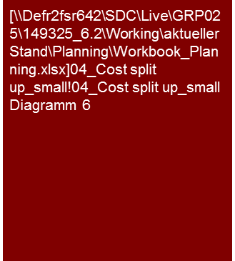
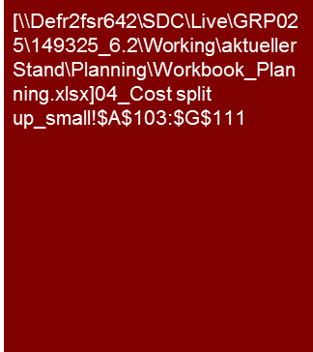

1. Are the investments planned consistently with the past and have investment needs that have been identified for the future considered in the planning?
Investment (Planning)
The XXX AG plans to expand investments in the planning period to reduce the existing investment backlog. Depreciation increases respectively in the course of the planning.
We consider the investment and depreciation planning to be XXX.
Depreciation and investments over time
XXX AG expects a significant increase of the investments above the level of depreciation/average investment in the past, as a result of the successive reduction of the investment backlog. These are primarily for XXX.
As a result of the investment activity the assets increase by ca. X % in the planning period.
The investments are primarily in XXX. They are above the level of depreciation/average investment in the past as a result of the successive reduction of the investment backlog.
[.... expansion vs. replacement investments .....]
[.... Additional explanations of investments ...]
[.... explanations of investments, depreciation method and assumed useful life ....]
[... Reproduction of complete investment cycle? Length of planning horizon? Transition to sustainable result → s. workbook Sustainable Result ...]
The depreciation increased slightly in the course of planning as a result of the investment sum being higher than depreciation.
Due to the high assumed useful life of the planned expansion investments the depreciation ratio increased only slightly compared to the investment ratio.
[.... explanations of depreciation and investment ratio (investments in % of sales ....)]
Actual
Plan
Note: (a) Depreciation ratio = Depreciation/Sales
(b) Investment ratio = Investments/Sales
Tools
Excel analysis
If applicable combined presentation with depreciation as presented in workbook Expenditures from Gross Profit to EBIT (Plan)

Slide 8
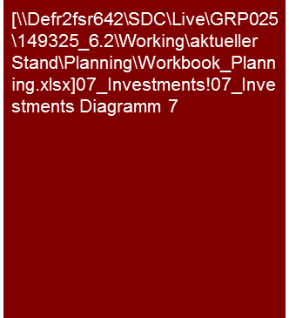
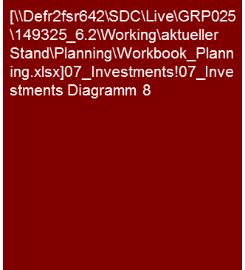
2. Are the investments consistent for sales planning and the planned business model?
Investment (Planning)
With a significant expansion of the investment activities XXX AG expects an increase in capacity and therefore to pave the way for sales increases.
Based on the technical full capacity in 2012, the degree of utilization can therefore be reduced to a long-term average level.
In view of this the overall planned investments appear to be understandable.
Capacity and degree of utilization
Actual
Plan
Investments and investment ratio
Actual
Plan
Other analyses and presentations sector-specific;
If capacity and utilization not available; analysis of net sales/ book value of assets (for example)
Tools
Excel analysis

Slide 9
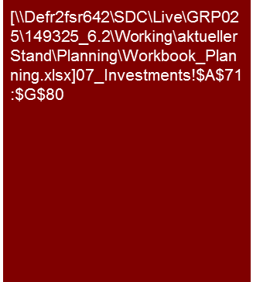
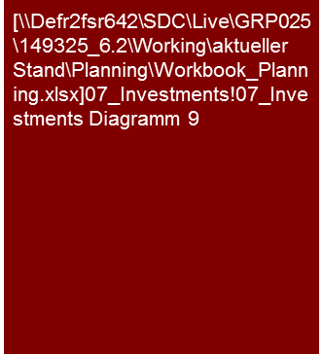
3. What are the investment projects?
Investment (Planning)
The XXX AG planned investments are primarily for three projects.
The cost estimates for these projects are understandable. The implemented controlling processes for cost controlling appear appropriate.
Primary investment projects
The investments of the XXX AG in the planning period are primarily for three projects XXX, YYY and ZZZ
[.... Brief description of the individual projects; on what basis are the cost estimates founded? Are there cost risks? Degree of completion? Status? Etc. ....]
[.... Brief explanation, if there are investments of a comparable magnitude after 2015? If yes, for what subjects? If not, what level is to be expected? ....]
Alternative
Investments in purchase, new building and modernization
Actual
Plan
Tools
Excel analysis

Slide 10


4. Are the planned investments consistent with the market expectations and sector parameters?
Investment (Planning)
The investment ratio of the XXX AG is in the range of comparable companies and the level expected by analysts.
Investment ratio in comparison to peer group
XXX
[.... Description of the relationship of XXX AG to peers ...]
[.... If there are deviations, explanation of reasons for such or consequences resulting for investment planning, growth and margin assumptions, etc. ....]
Investment ratio in comparison to analysts’ expectations
Tools
Excel analysis

Slide 11
© 2017 KPMG International Cooperative (“KPMG International”). KPMG International provides no client services and is a Swiss entity with which the independent member firms of the KPMG network are affiliated.

